Slide 1
IMPROVING THE RETURN LOSS OF THE ANTENNA VIA FRACTAL SLOT
BY,
D.YUVARAJ DHAYAL
S.KANTHARAJ

Slide 2
OBJECTIVE
To design a fractal H shaped notch loaded patch antenna for satellite communication applications with operating frequency of 3.09 GHz on the Arlon Cu Clad 217 substrate with the dielectric constant of 2.2.

Slide 3
LITERATURE SURVEY

Slide 4
Title | Improving the return loss of the Antenna via fractal slot
Authors | Zubair Ahmed, Awab Muhammad & Mojeeb Bin Ishan
Publication | IEEE Antennas and Wireless Propagation Letters volume: 10,no.1 ,pp. 108-113, 17 February 2022
Overview | Operates at frequency of 3.09MHz.(S band) a fractal-slot at center is to remove the unwanted out-of-phase current regions. improves SLL, return loss, and bandwidth of notch-loaded TM ₃₀ mode
Performance measure | Return loss : -16.1 measured gain of 13 dB
1

Slide 5
Title | Bandwidth Enhanced Miniaturized Patch Antenna Operating at Higher Order Dual-Mode Resonance Using Modal Analysis
Authors | A.Battacharyya ,J.Pal, K.Patra and B.Gupta
Publication | IEEE Antennas and Wireless Propagation Letters Volume: 20, Issue 2, February 2021
Overview | rectangular microstrip antenna operating at a higher order at TM03 mode. antenna efficiency at the design frequency of 5.8 GHz. A wide slot reduces side lobes of the radiation pattern. The antenna is fed by a coaxial probe and is easy to fabricate
Performance measure | Excitation of this TM03 mode increases gain impedance bandwidth of 8.5% Peak gain of 10.5 dB.
2

Slide 6
Title | Differentially-Fed Circular Patch Antenna under Dual High-order Modes for Enhanced Bandwidth and Stable High Gain
Authors | X.Zhang, K.D.Hong ,L.Zhu ,X.K.Bi and T.Yuan
Publication | IEEE Trans.Antennas Propag.,vol.69,no.1 ,pp.508-513,Jan.2021.
Overview | broadside radiation of TM ₃₁ mode is increased. Sidelobe is reduces by the current of TM ₁₂ mode is reshaped to be more in-phase The current distribution of TM ₃₁ mode is reconstructed by loading two open slots at the edge of patch
Performance measure | Antenna produces high gain up to 13.7 dB. Beamwidth and gain level are kept stable Bandwidth of 12.9%.
3

Slide 7
Title | Broadband and High-Gain Microstrip Patch Antenna Loaded With Parasitic Mushroom-Type Structure
Authors | Yufan Cao, Yang Cai, Wenquan Cao, Baokun Xi and Zuping Zian
Publication | IEEE Trans.Antennas Propag.,vol.18, pp. 1405-1409,2019
Overview | TM 30 mode& TM 10 mode is used. Wideband performance is realized based on two combined modes. High gain are achieved over the entire operating bandwidth.
Performance measure | impedance bandwidth is from 11.9 to 18.2 GHz, peak-radiating gain between 10 and 10.5 dB. wide bandwidth, flat and high gain
4

Slide 8
Title | Bandwidth Enhancement of a Differential-Fed Equilateral Triangular Patch Antenna via Loading of Shorting Posts
Authors | L.Guo, H.Yu, W.Che, and W.Yang
Publication | IEEE Trans. Antennas Propag., Vol.67 ,no.5, pp.3132-3139, May 2019.
Overview | Offset-fed reflect array centered at 10 GHz designed and constructed. The dimensions of patch is same for all elements The phase variation is achieved by adjusting the length of the etched slots within the patches.
Performance measure | 1 dB gain bandwidth of 23% is obtained Aperture efficiency of 67% Cross-polarization level of 26 dB at 10 GHz.
5

Slide 9
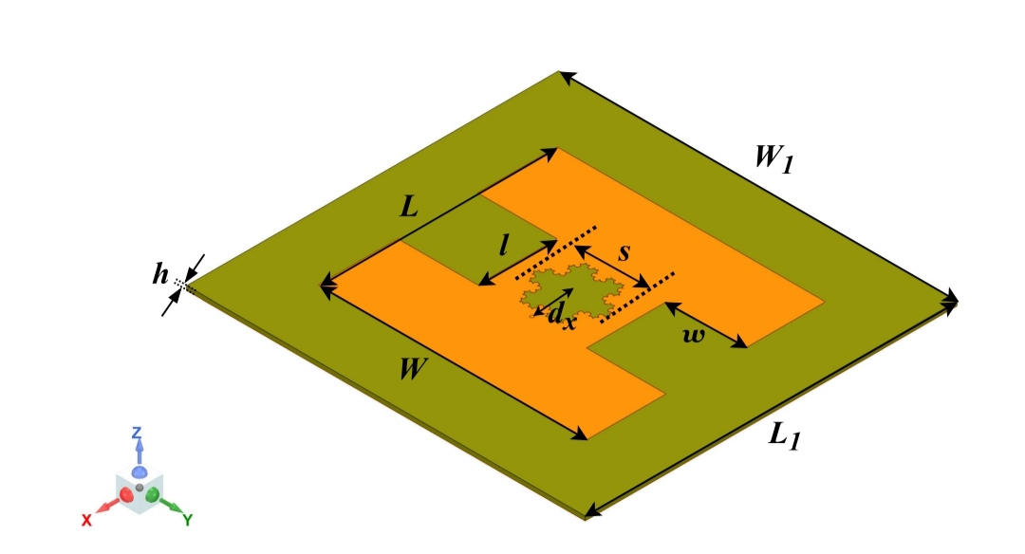
DESIGN &CONFIGURATION OF PROPOSED ANTENNA
PARAMETERS | mm
L | 90
W | 101
l | 30
w | 30
L1 | 140
W1 | 150
dx | 15

Slide 10
Dielectric material: Arlon Cu Clad 217 substrate
Relative permittivity=2.2 mm
Thickness h=1.5mm
L1- length of the ground or substrate plane
W1-width of the ground or substrate plane
L-length of the patch antenna
W-width of the patch antenna
l-length of the fractal slot
w- width of the fractal slot
dx- radius of the slot

Slide 11
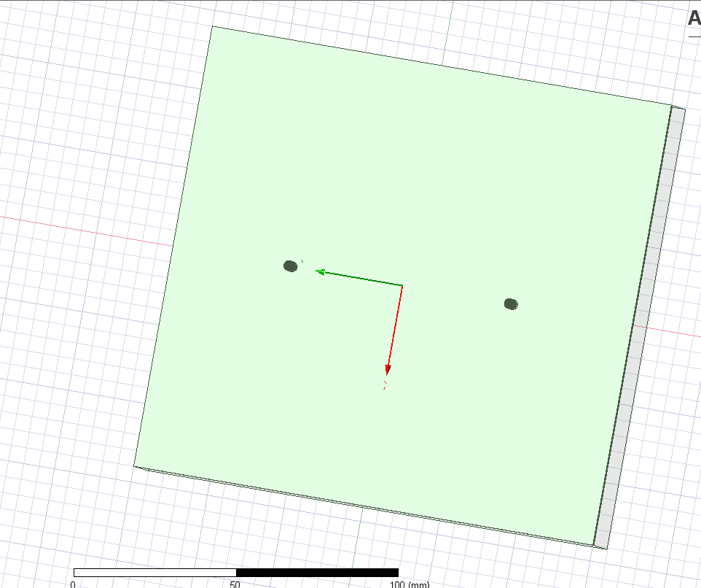
PROGRESS:
CREATING A GROUND PLANE OF SIZE 140*150 mm^2

Slide 12
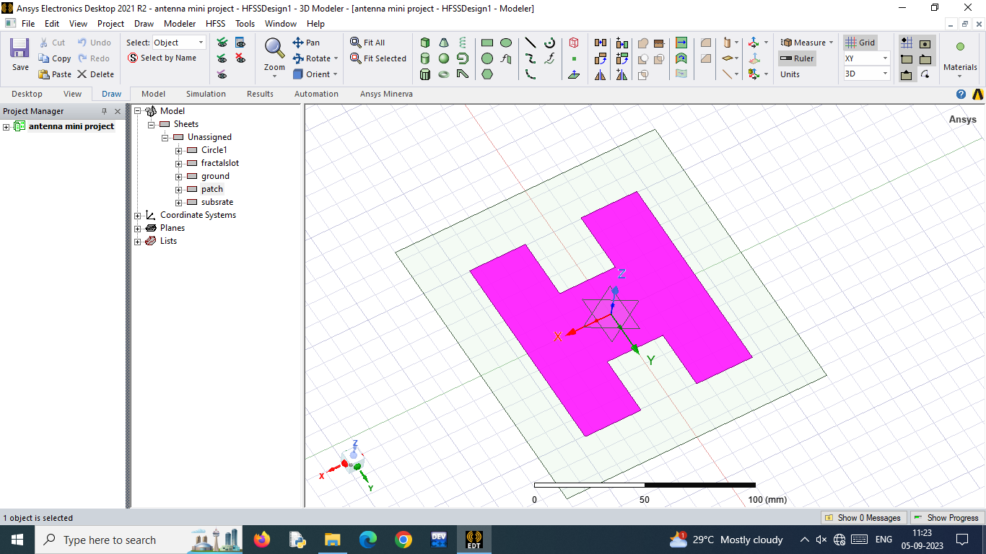
CREATING THE PATCH OVER THE SUBSTRATE

Slide 13
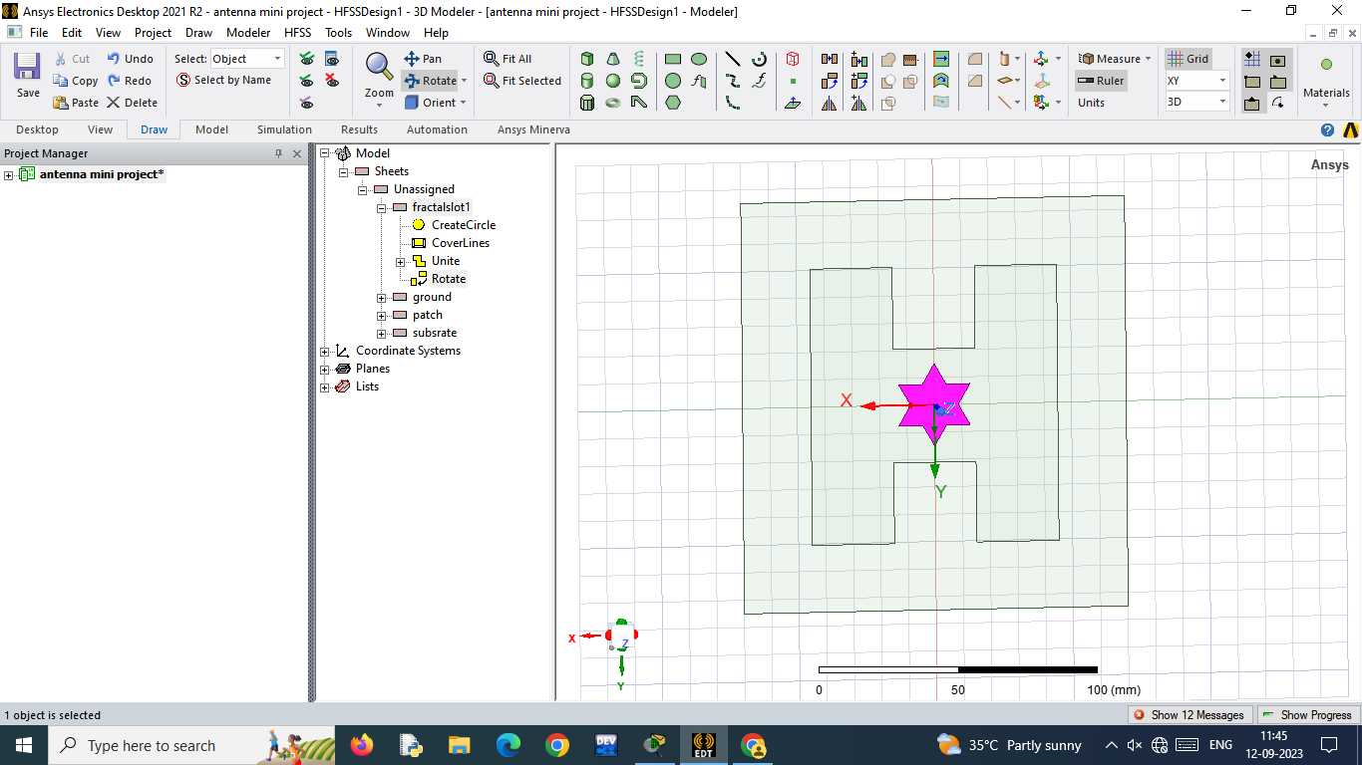
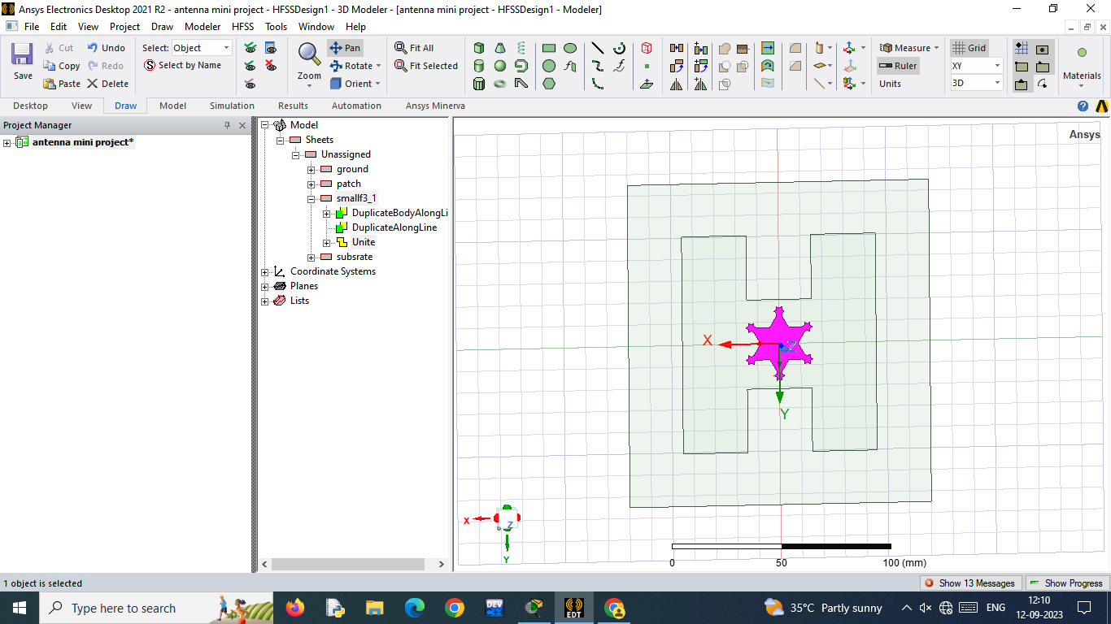
CREATION OF THE FRACTAL SLOT
FRACTAL SLOT AFTER UNITING
ITERATION1

Slide 14
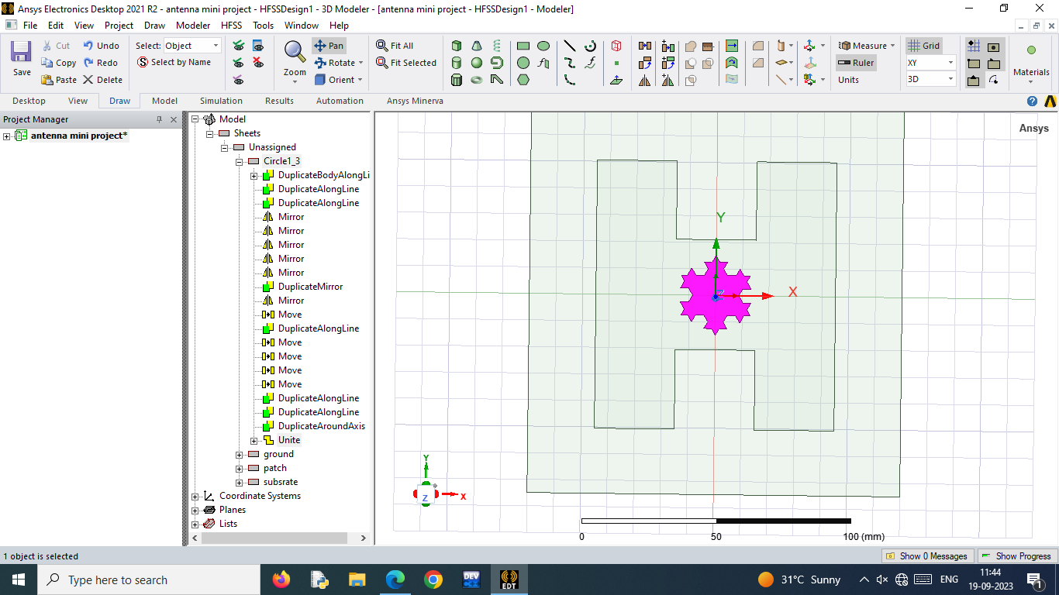
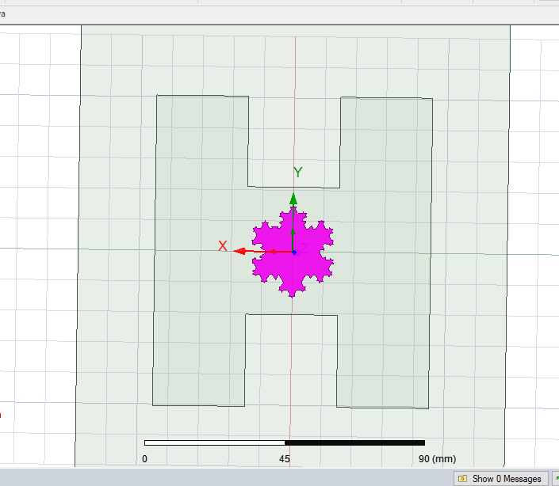
2ND ITERATION
AFTER FURTHER ITERATIONS

Slide 15
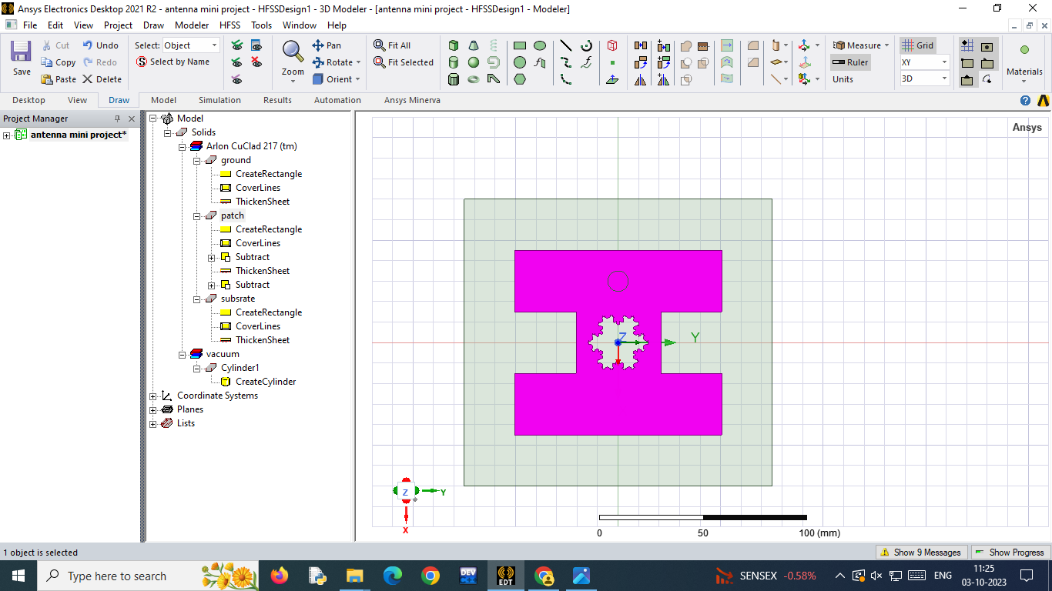
PATCH WITH FRACTAL SLOT

Slide 16
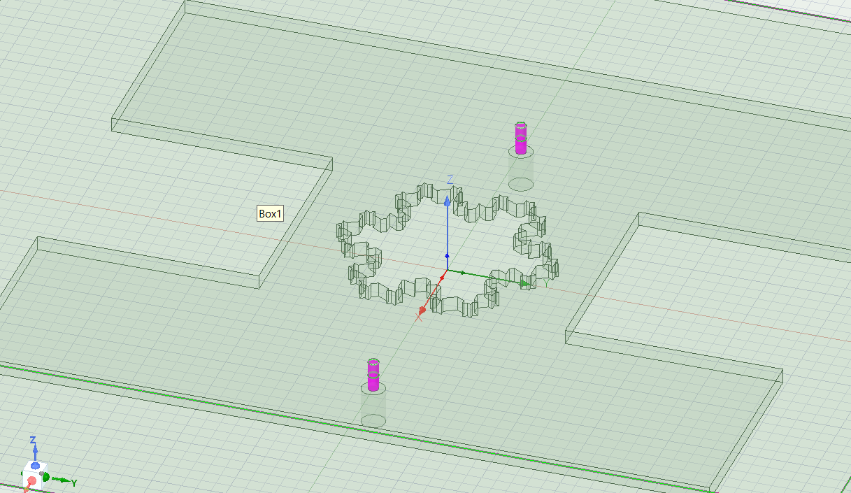
PROVIDING DIFFERENTIAL FEED
FRONT VIEW :

Slide 17
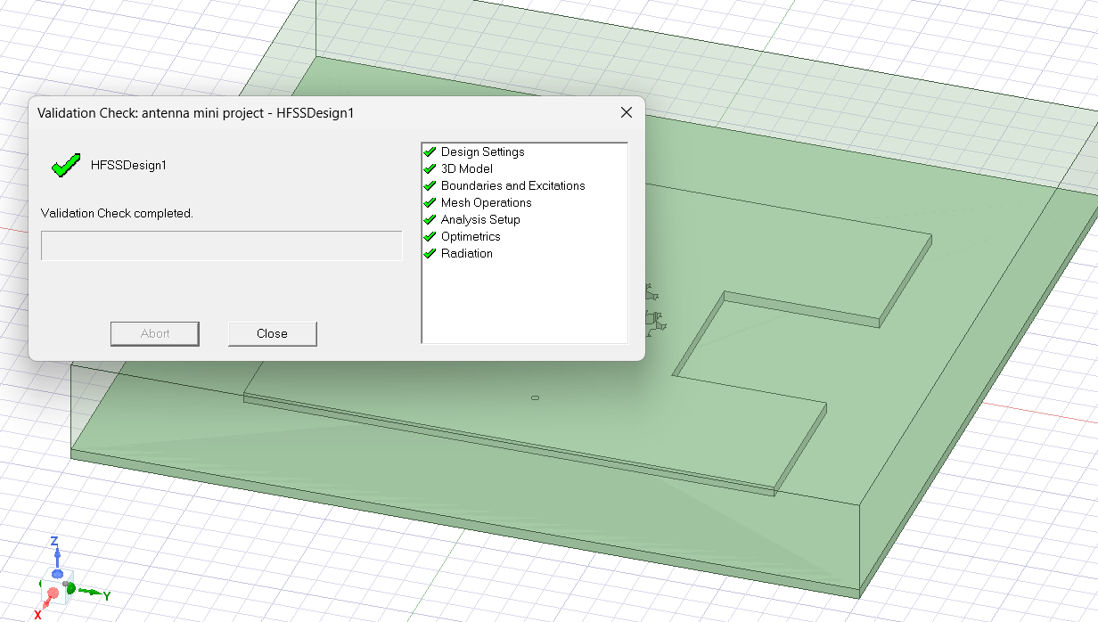
VALIDATION CHECK

Slide 18
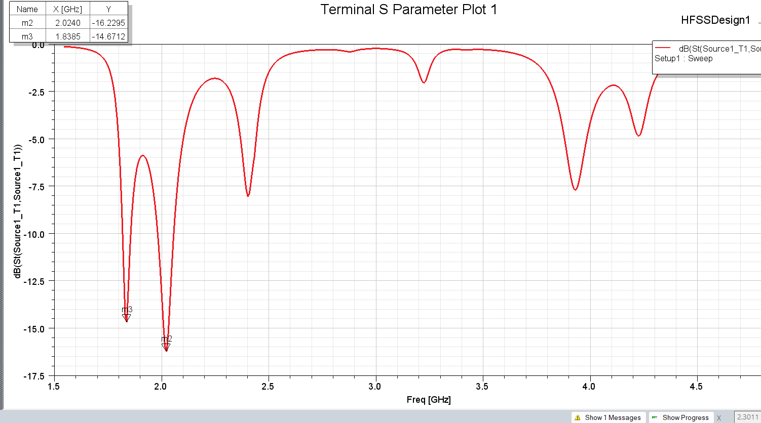
Return loss is found to be -16.22 at the frequency of 2.02GHz
RETURN LOSS

Slide 19
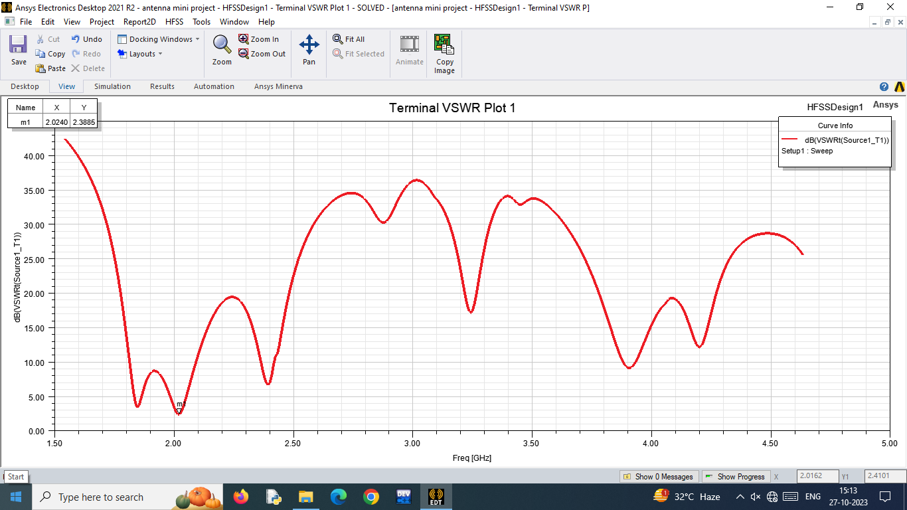
VSWR
VSWR is found to be 2.38 at 2.02GHz.

Slide 20
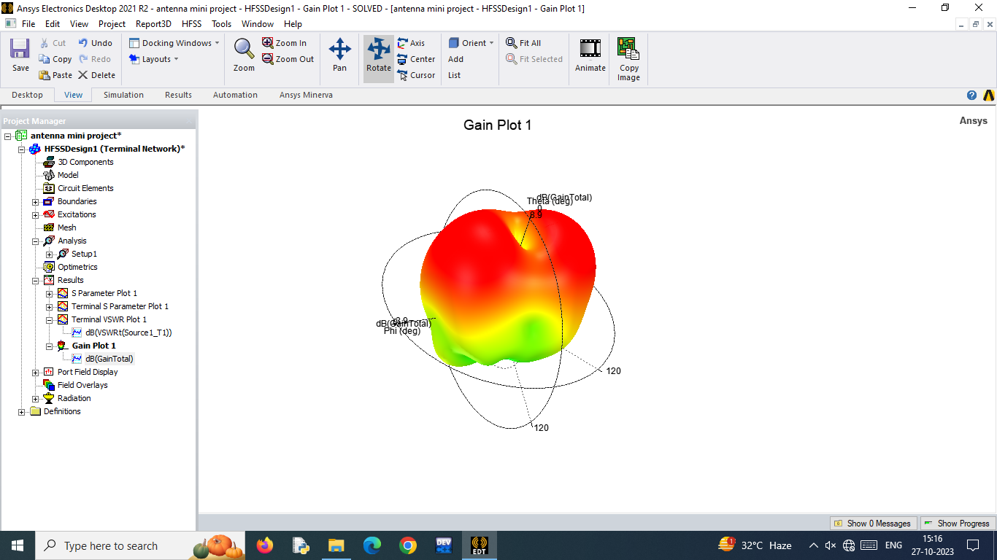
GAIN
Gain of the antenna is found to be around 8.9

Slide 21
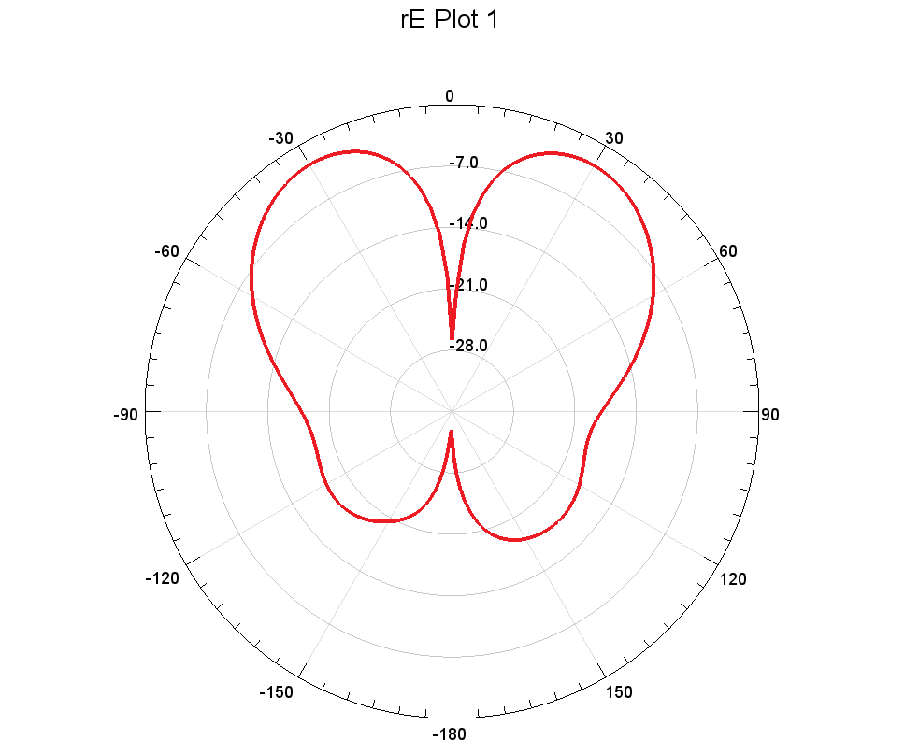
RADIATION PATTERN

Slide 22
CONCLUSION
Thus, we obtained the operating frequency as 2.02 GHz for the designed antenna because there is a sharp drop in 2.02GHZ and it will not perform well in other frequencies. After stimulation the obtained results are Return loss is found to be -16.22,VSWR as 2.38 and gain as 8.9. The antenna is designed through multiple iterations process through result analysis and necessary modification. The measured and simulated results of the antenna are good.

Slide 23
REFERENCES
P. Juyal and L. Shafai, " Sidelobe reduction of TM 12 mode of circular patch via nonresonant narrow slot ", IEEE Trans. Antennas Propag., vol. 64, no. 8, pp. 3361-3369, Aug. 2016.
Z. Ahmed, M. M. Ahmed and M. B. Ihsan, "A novel differential fed high gain patch antenna using resonant slot loading", Radioengineering, vol. 27, pp. 662-670, Sep. 2018.
X. Zhang and L. Zhu, " Dual-band high-gain differentially fed circular patch antenna working in TM 11 and TM 12 modes ", IEEE Trans. Antennas Propag., vol. 66, no. 6, pp. 3160-3165, Jun. 2018.
X. Zhang, L. Zhu and Q.-S. Wu, " Sidelobe-reduced and gain-enhanced square patch antennas with adjustable beamwidth under TM 03 mode operation ", IEEE Trans. Antennas Propag., vol. 66, no. 4, pp. 1704-1713, Apr. 2018.
Y. He, Y. Li, W. Sun and Z. Zhang, "Dual-polarized high-gain and low-profile magnetic current array antenna", IEEE Trans. Antennas Propag., vol. 67, no. 2, pp. 1312-1317, Feb. 2019

Slide 24
X. Zhang, K.-D. Hong, L. Zhu, X.-K. Bi and T. Yuan, "Wideband differentially fed patch antennas under dual high-order modes for stable high gain", IEEE Trans. Antennas Propag., vol. 69, no. 1, pp. 508-513, Jan. 2021.
N.-W. Liu, L. Zhu, W.-W. Choi and X. Zhang, " A low-profile differential-fed patch antenna with bandwidth enhancement and sidelobe reduction under operation of TM 10 and TM 12 modes ", IEEE Trans. Antennas Propag., vol. 66, no. 9, pp. 4854-4859, Sep. 2018
Z. Ahmed and M. M. Ahmed, " Sidelobe reduction and gain enhancement in higher order TM 30 and TM 70 mode rectangular patch antennas via partial notch loading ", IET Microw. Antennas Propag., vol. 13, no. 12, pp. 1955-1962, Oct. 2019.
J. Anguera, A. Andujar and J. Jayasinghe, " High-directivity microstrip patch antennas based on TM \$_{odd-0}\$ modes ", IEEE Antennas Wireless Propag. Lett., vol. 19, no. 1, pp. 39-43, Jan. 2020.
A. Bhattacharyya, J. Pal, K. Patra and B. Gupta, "Bandwidth-enhanced miniaturized patch antenna operating at higher order dual-mode resonance using modal analysis", IEEE Antennas Wireless Propag. Lett., vol. 20, no. 2, pp. 274-278, Feb. 2021

Slide 25
THANK YOU

